Slide 1
Counting of Dinoflagellates
Putnam Lab URI Q1 2019

Slide 2
Summary
Instrument | Cellometer T4 | Cellometer K2 | Cellaca MX
Dinoflagellates “frozen” Brightfield | Yes | Yes | Yes
Dinoflagellates “Frozen” fluorescence | No | Yes | Yes
Dinoflagellates “Live” with debirs Brightfield | No | No | No
Dinoflagellates “Live” with debirs Fluorescence | No | Yes | Yes
Time to count 1000 samples | ~23 hours | ~23 hours | ~ 2 hours

Slide 3
Summary
In Fresh samples, Brightfield only will not work, there is too much debris.
Red chlorophyll fluorescence is best for counting dinoflagellates (debris and coral host cells are not red fluorescent)
Host coral cells can be stained with Acridine orange.
GFP from Host coral cells can be imaged.
For one sample at a time, the Cellometer K2 is the best instrument to use.
However: due to the number of samples I would highly recommend the Cellaca MX.
1000 samples in 2 hours vs 23 hours over multiple days with Cellometer K2.

Slide 4
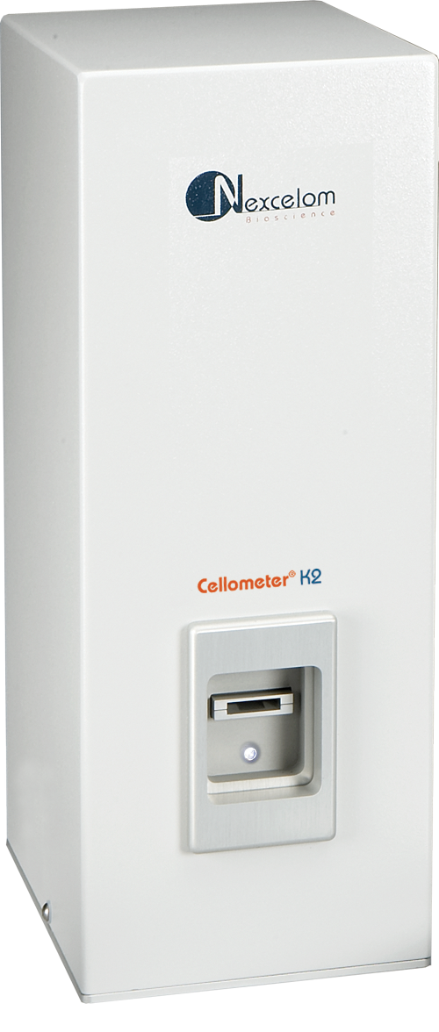
Cellometer K2 Image Cytometer
Fluorescent automated cell counter for complex primary samples
Imaging channels: Brightfield, Green and Red fluorescence channels.
Optics: Cellometer X2 10x objective,
Cellometer K2 5x objective. (Recommended for this application)
Sample volume: 20uL / sample
Image up to 8 areas per slide for best statistical sampling.
Timing: ~60 seconds / count
1000 samples ~ 23 hours. Based on companies who count 150 sample batches with 3 scientists for 3.5 hours.
Cost: 75c/ count with case of 900 slides.

Slide 5
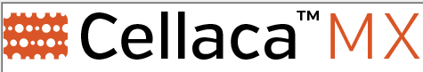
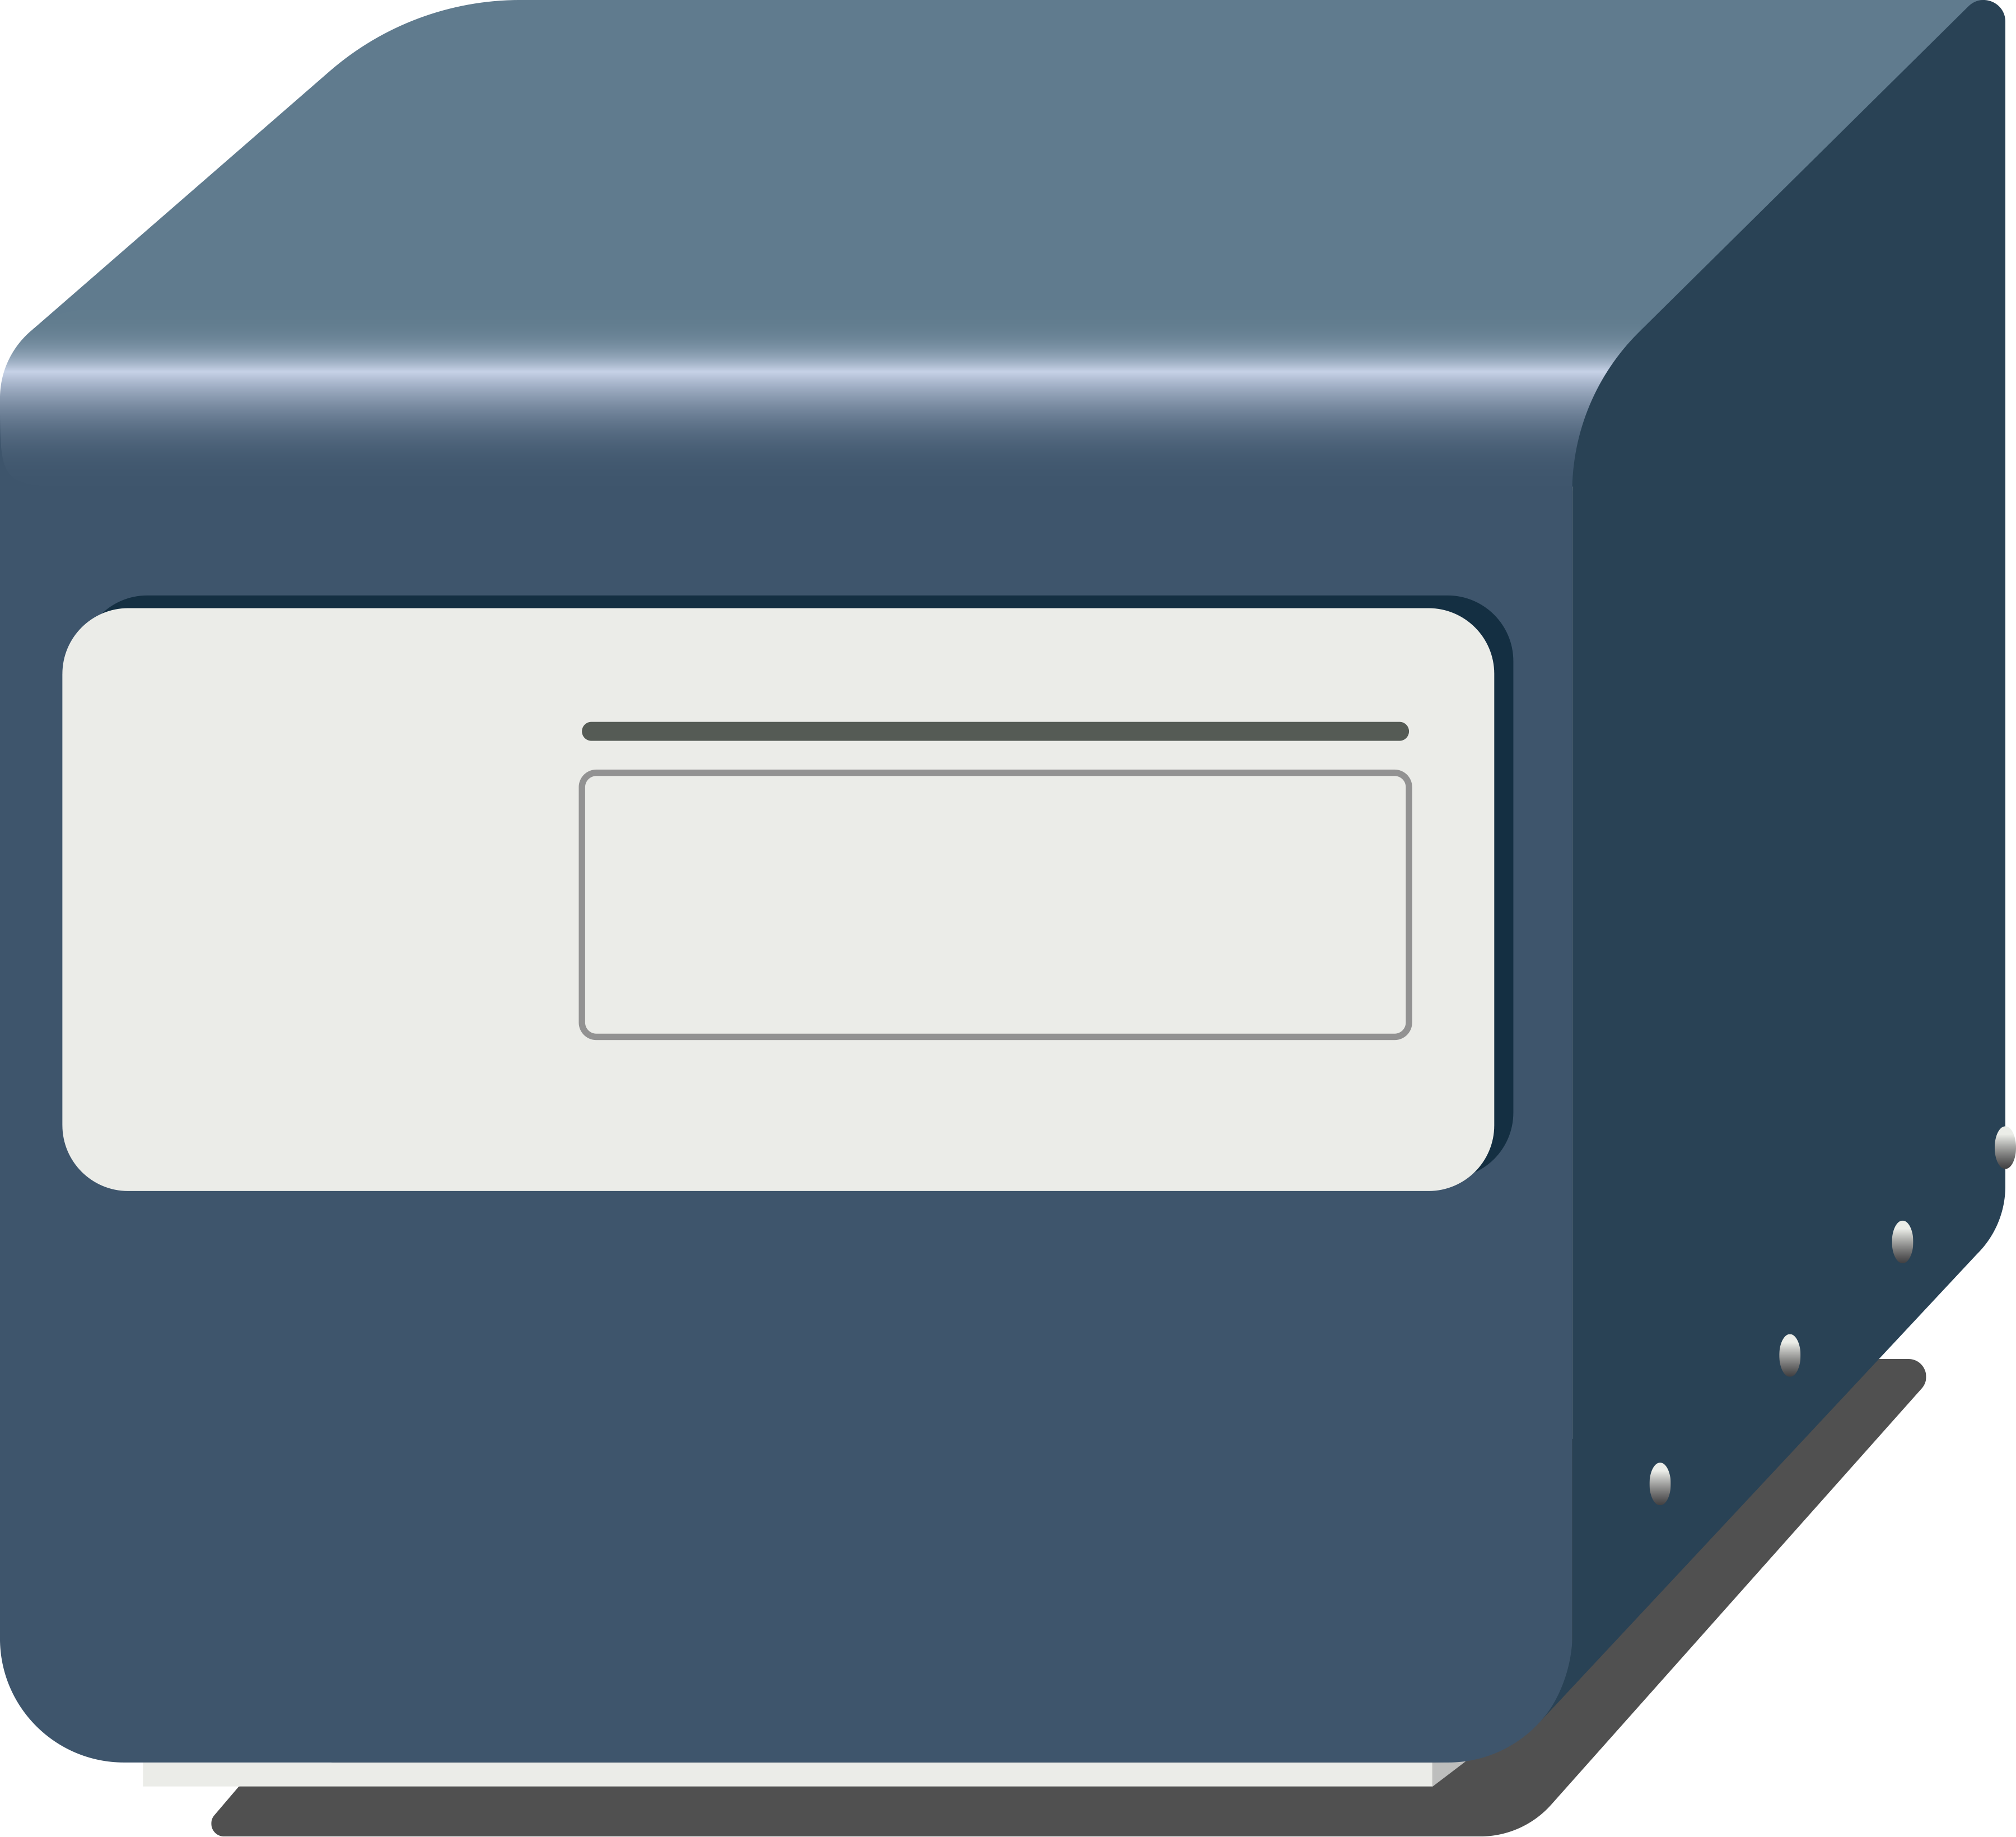
High throughput fluorescent automated cell counter for complex primary samples
Imaging channels: Brightfield, Fluorescence 4 Excitation, 5 independent emission channels.
Optics: ~5x objective. (Recommended for this application)
Images equivalent of 7 Cellometer K2 images.
Sample volume: 50 µL min sample vol.
Timing: ~2.5 min for 24 counts.
1000 samples ~ 2 hours. Limiting step is sample prep
Cost: $1/ count

Slide 6
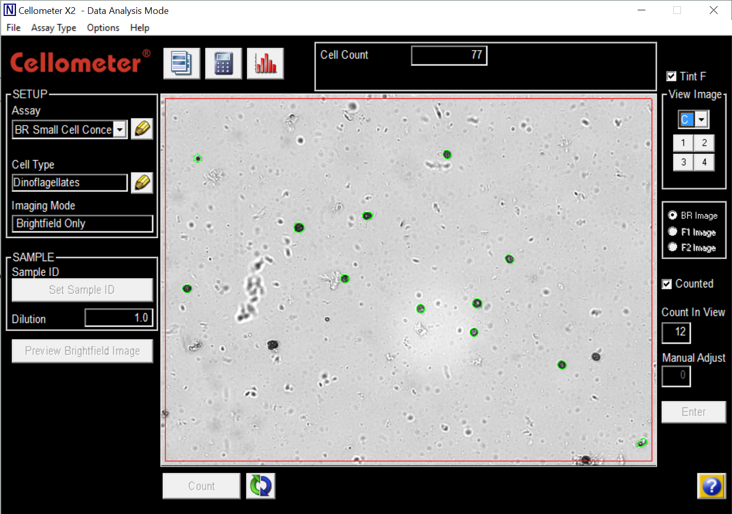
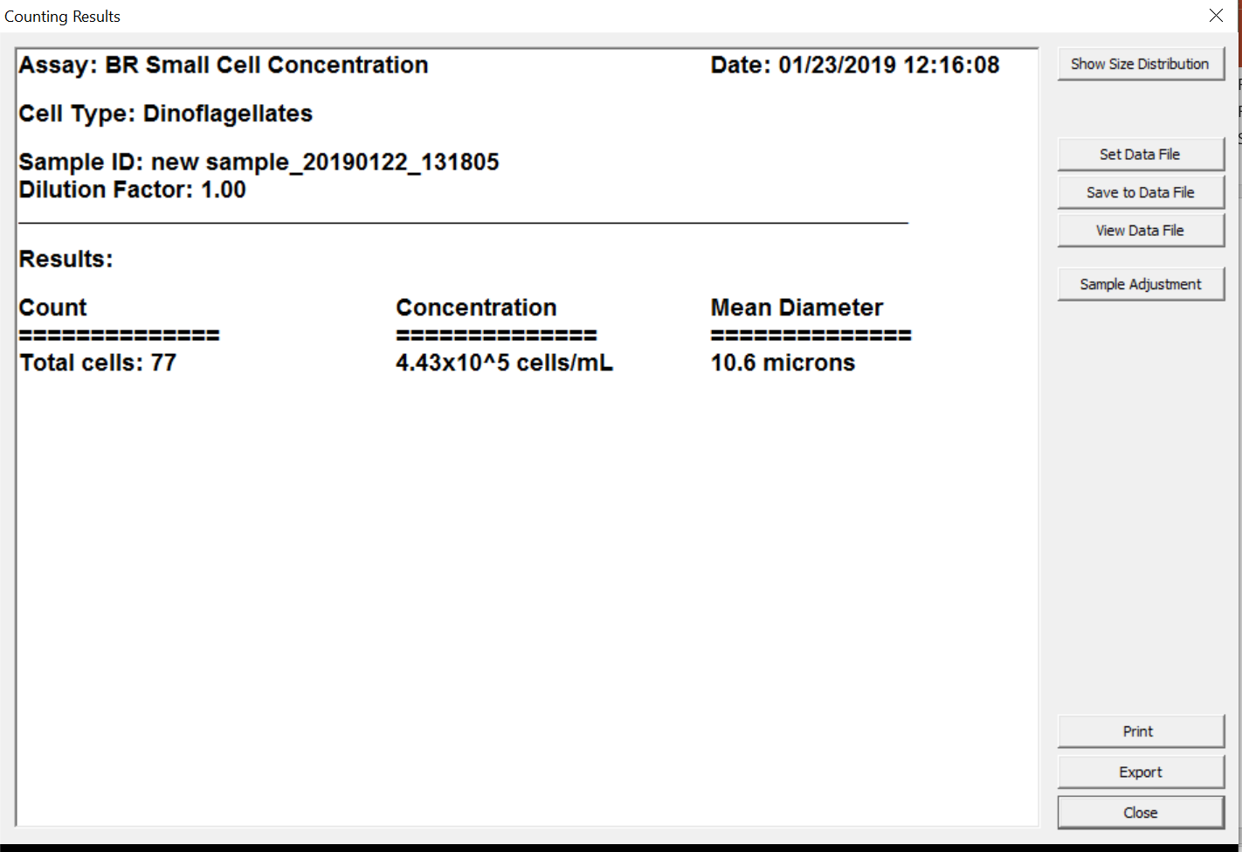
Brightfield counting of dinoflagellates
Even in the cleaner frozen sample, non dinoflagellate debris can complicate detection. In this Cellometer X2 image 12/14 dark objects are counted.

Slide 7
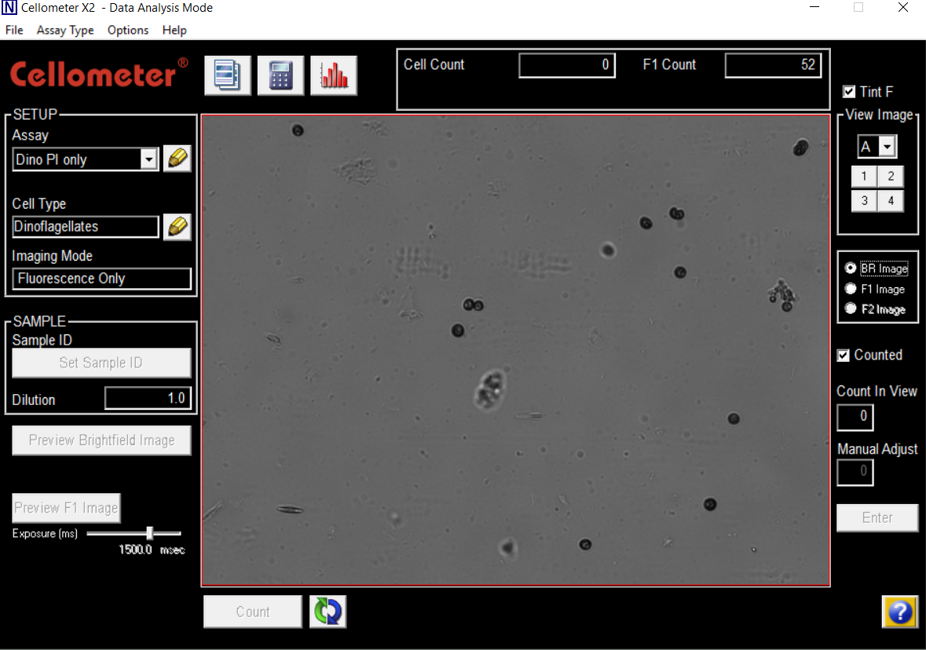
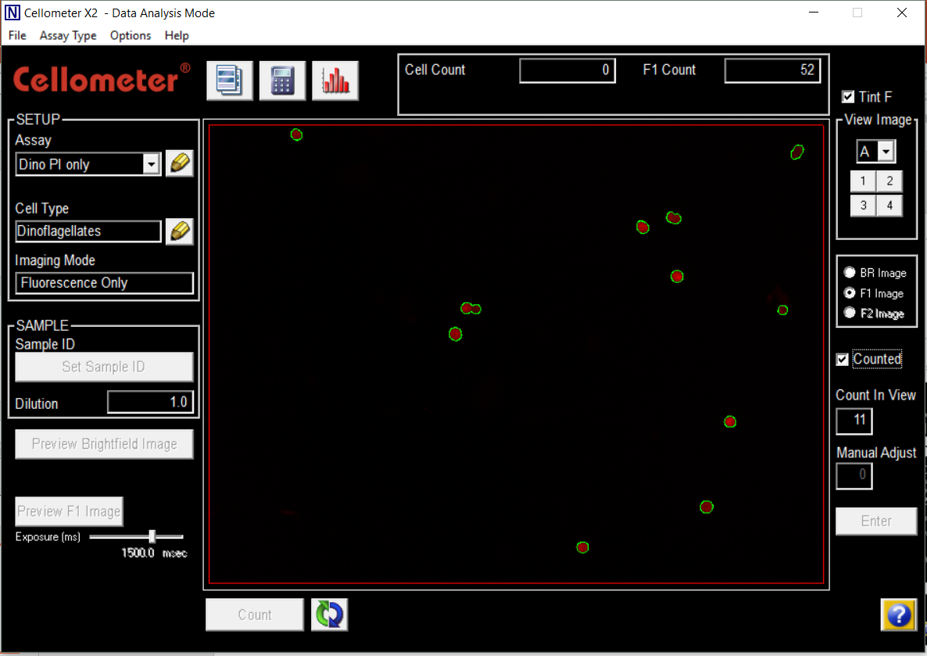
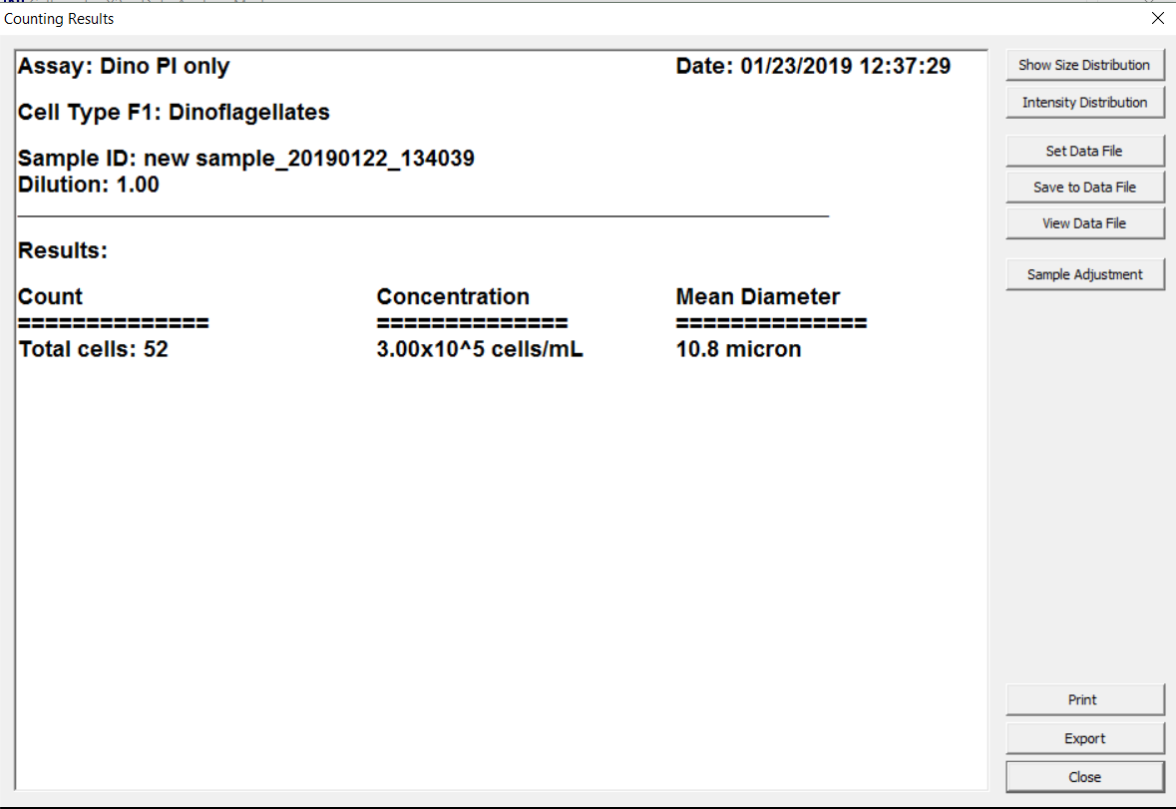
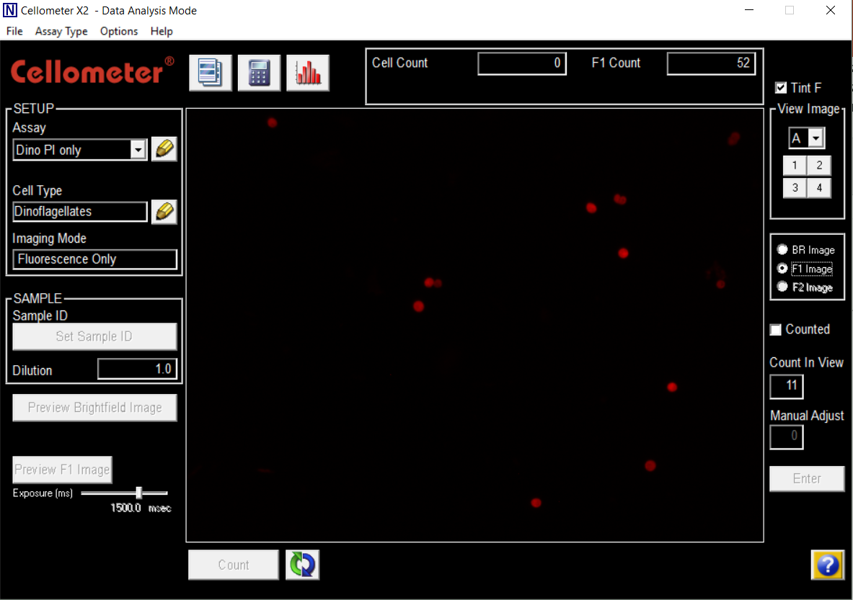
Red chlorophyll fluorescence enables counting of dinoflagellates
In this assay, only those objects that are red fluorescent are counted. Debris and other non fluorescent cells are ignored.
Counted red fluorescence image

Slide 8
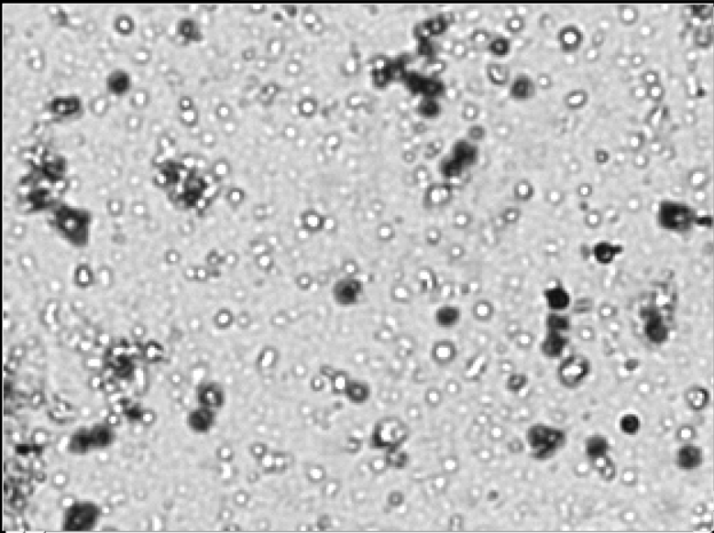
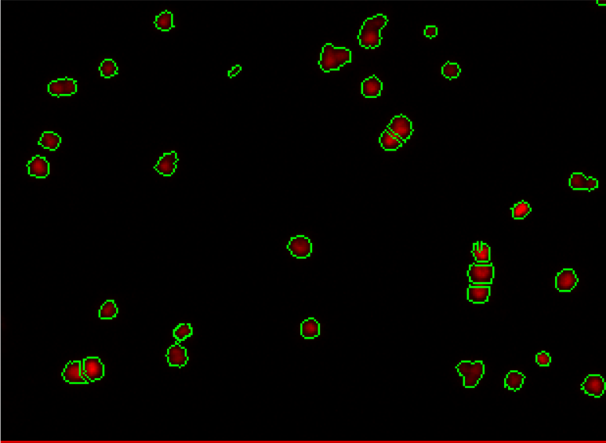
Fluorescence is necessary for accurate dinoflagellate counts in fresh samples with debris
Corresponding brightfield and red fluorescence images. Red arrows indicate dark debris that are not fluorescent. (image from Cellometer K2 taken in nexcelom office)

Slide 9
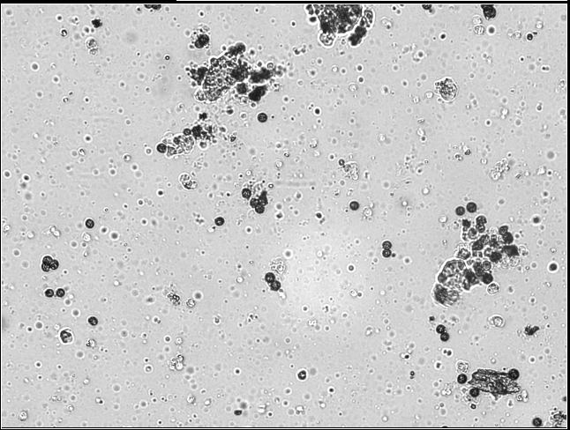
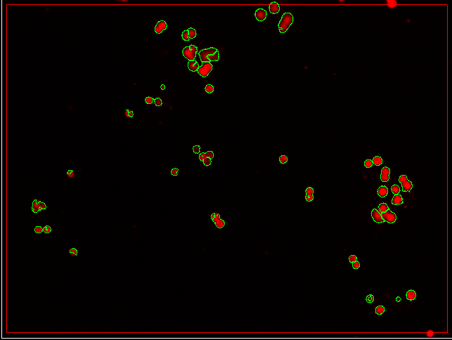
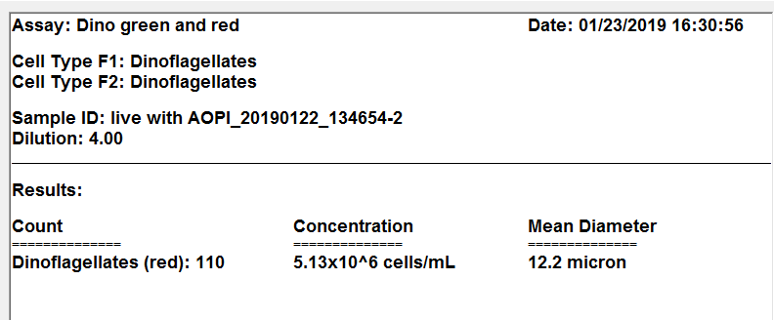
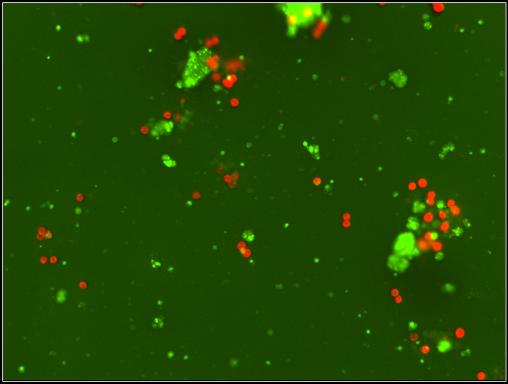
Coral host cells can be stained with Acridine orange.
Only those objects with red fluorescence were counted.
Overlay of green (Acridine orange) and red (chlorophyll) fluorescence image. Coral host cells were stained with acridine orange.

Slide 10
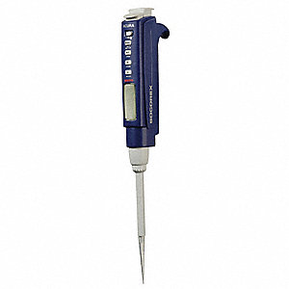
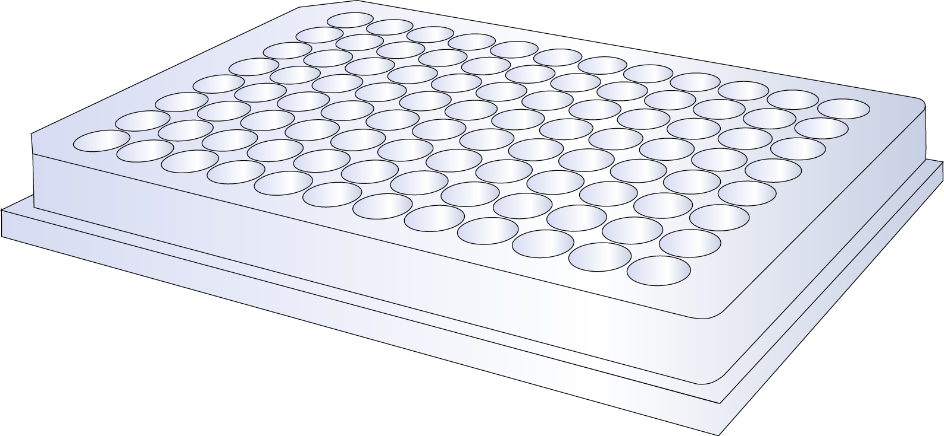
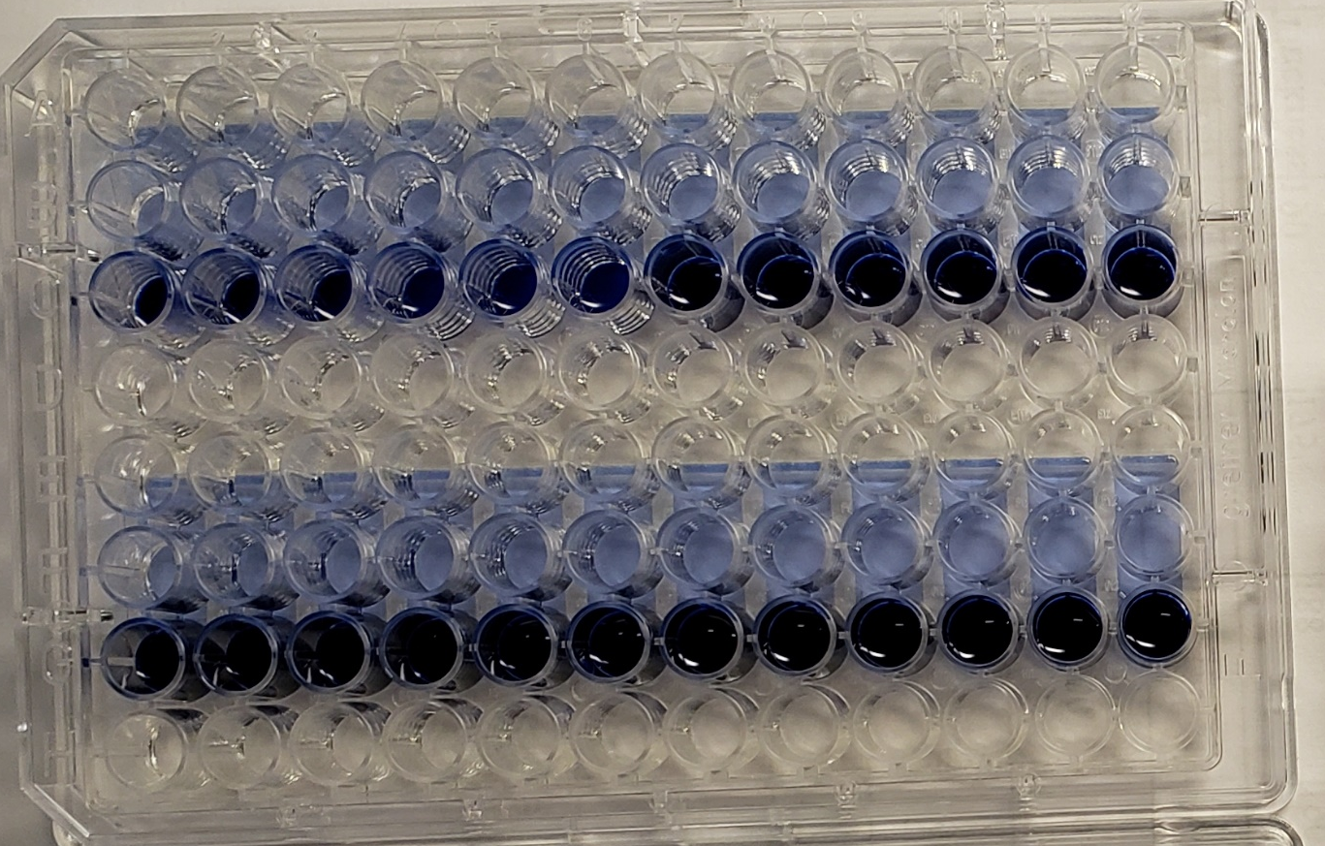
Cellaca MX: 24 samples at a time.
Counting Results
sample name count type cell count concentration mean diameter
B1 F1 469 4.48e+05 Cells/mL 11.5
Pipette 50- 200 uL of sample
Up to 24 samples / plate
x42
Dinoflagellate samples in 2.5 minutes.
1000 samples ~ 120 min
120 min
Cellaca plate with trypan blue to show counting cambers

Slide 11
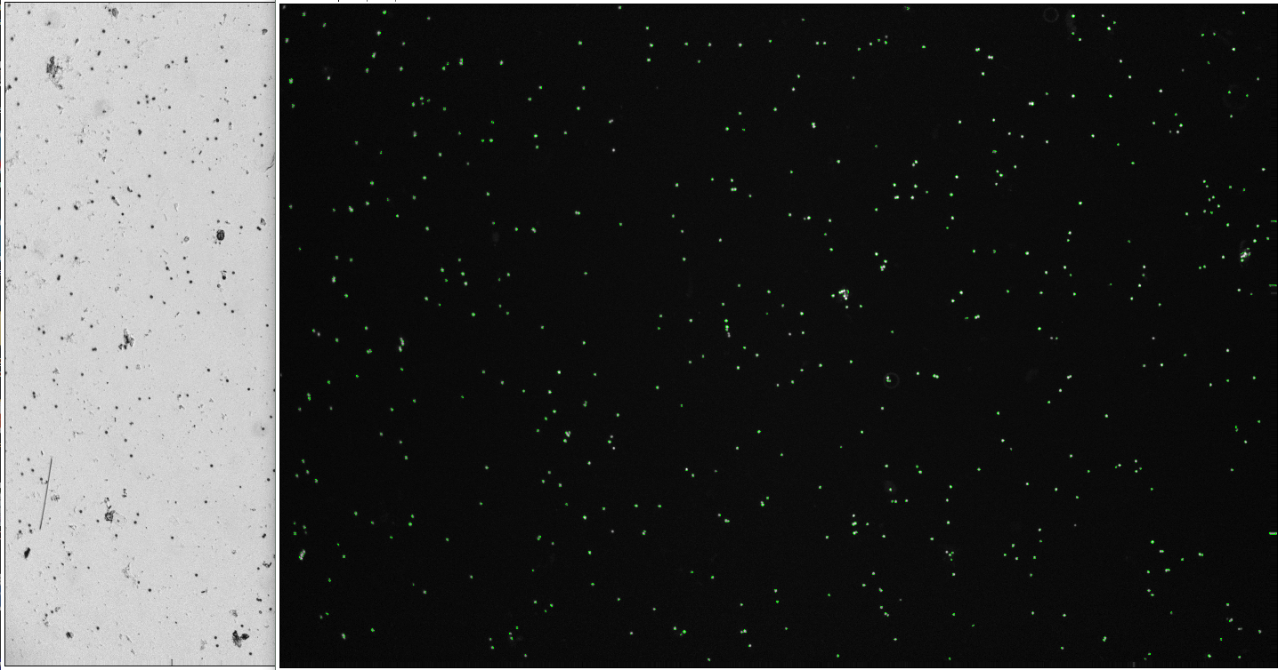
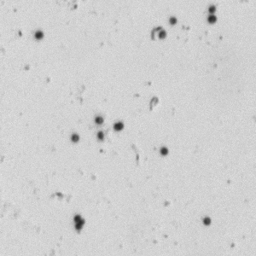
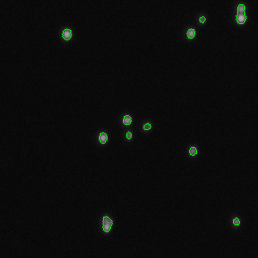
Cellaca Image = 7 K2 images
Zoomed in BrightField from “Frozen” sample, Cellaca MX
Zoomed in counted red fluorescence, Cellaca MX

Slide 12
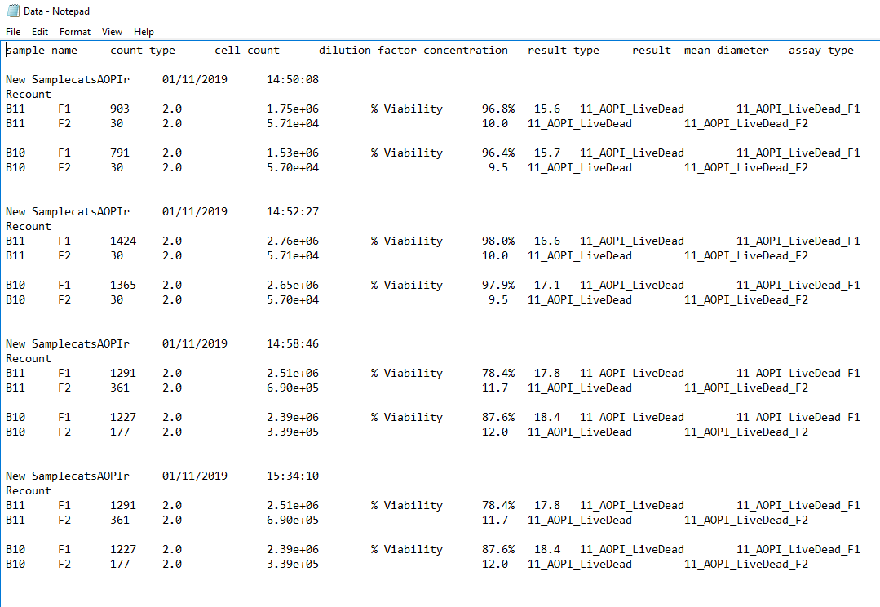
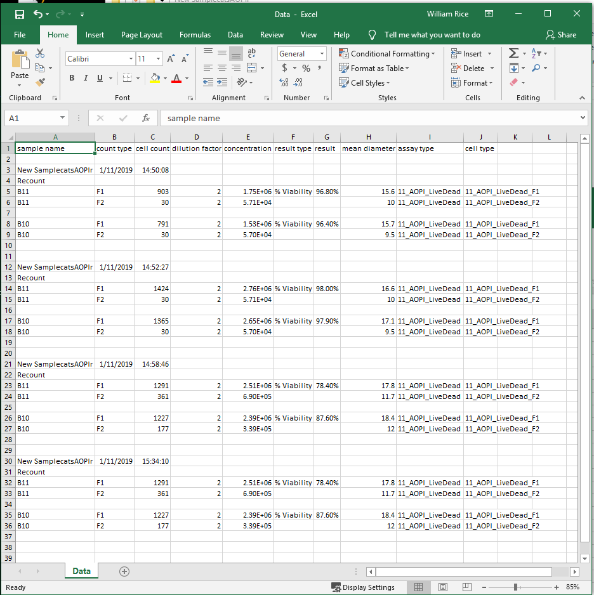
Cellometer and Cellaca results data can be directly imported into excel.
sample name count type cell count dilution factor concentration mean diameter
B1 F1 469 1.0 4.48e+05 Cells/mL 11.5
B2 F1 469 1.0 4.48e+05 Cells/mL 11.5
CSV file can be opened directly in excel
Cellaca data is saved as a CSV file for each plate

Slide 13
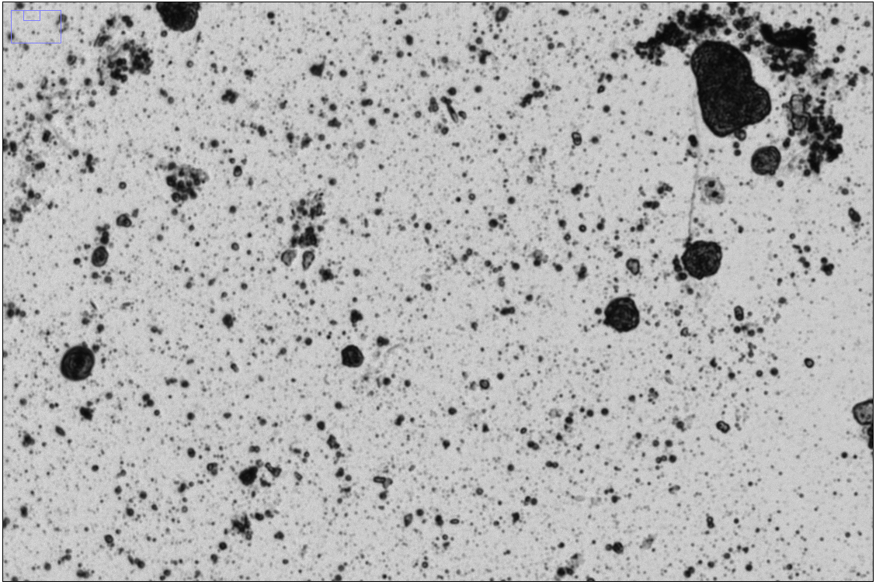
Zoomed in BrightField from “fresh” sample, Cellaca MX

Slide 14
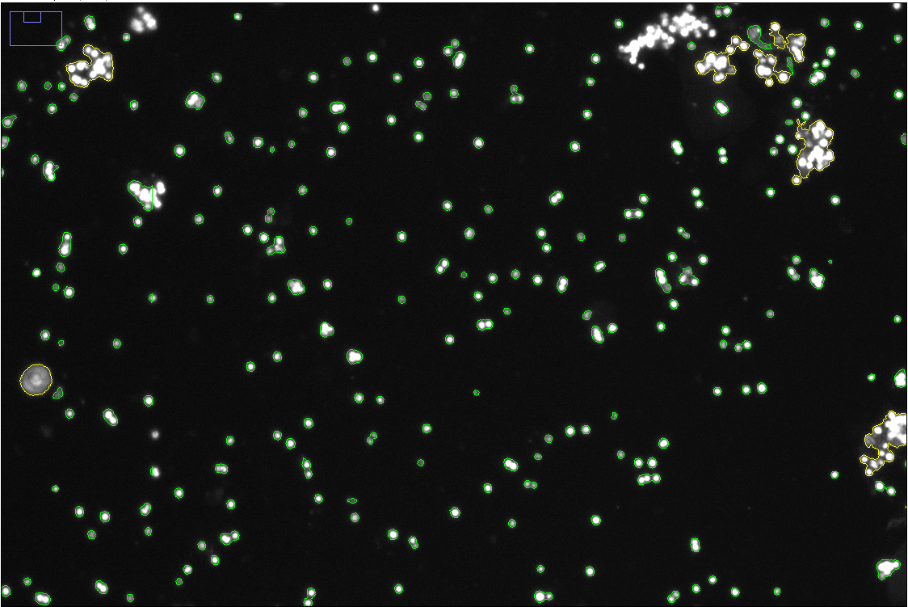
Zoomed in red fluorescence from “fresh” sample, Cellaca MX

Slide 15
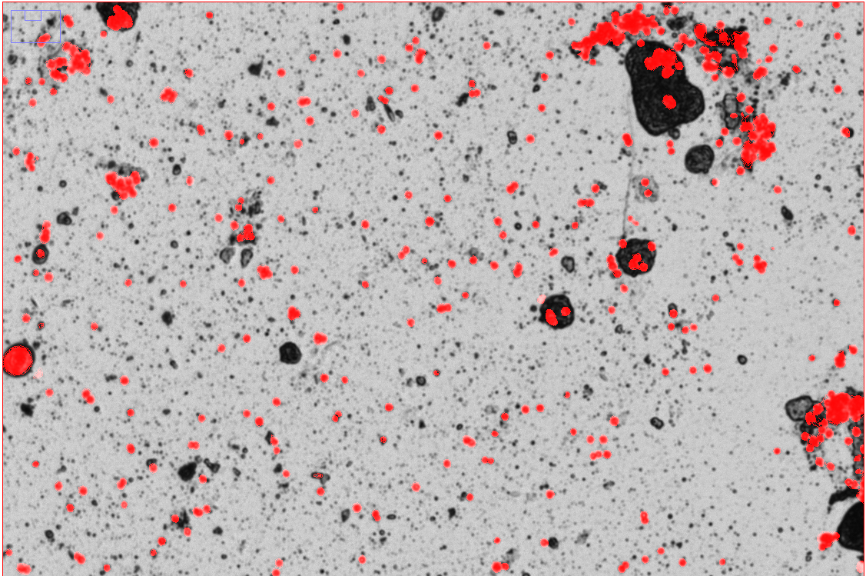
Overlay of chlorophyll fluorescence and BF from “fresh” sample, Cellaca MX

